Slide 1




MLB Betting Prediction Web App
Using statistics and correlational data compared to betting site odds to predict the best choice for bets on MLB games.

Slide 2
Predicting Outcomes of MLB Games
When it comes to predicting the outcomes of a baseball game, there are many variables to consider that can be difficult to track and find correlations in.
There are many precise and specific stats tracked in the MLB, for individual players and teams as a whole, that may be difficult for the casual observer to assign importance in predictions
For both casual and serious spectators, the sheer amount of data to consider in making predictions can be overwhelming

Slide 3
Why?
Personal Interests, ambitions and capabilities
Big Data / Data Analytics
Underdeveloped field
Econometrics
Baseball statistics

Slide 4
Potential techniques
The goal is to use large data sets to make predictions using
API calls
Data Science
Regressions
Machine Learning
Databases

Slide 5
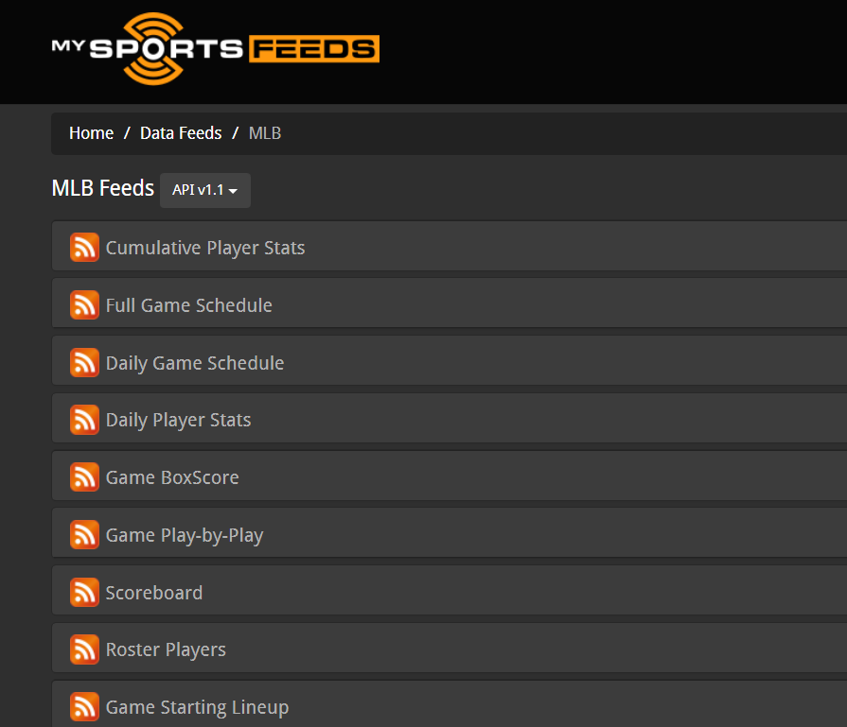

Which API?
We have limited options
$1 a month for non-commercial use
Provides more than enough data
mysportsfeeds.com

Slide 6
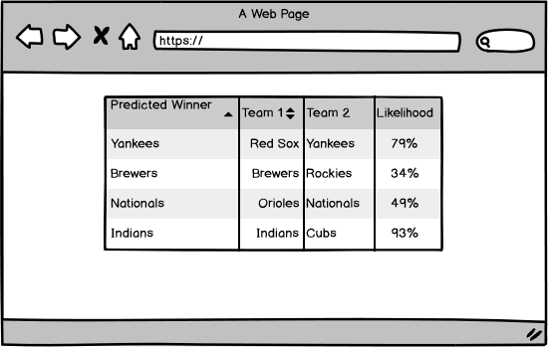
Information architecture
Example of Results
Possible Additional Results:
Best bets based on odds
Over/Under predictions
Safety vs. Risk
Estimated runs in an inning

Slide 7
Appeals To
Beginners trying to get into betting world
People interested in the sport/invested in fantasy baseball
Veterans trying to compare our information with other predictive sites information
Fan trying to buy tickets to a winning game

Slide 8
Goal Moving Forward
Create an algorithm that is as accurate as possible
Know how to use statistics/data in the best way to decide the winner
Give accurate predictions
Make information easy to digest for users
Stretch goal: continue making algorithms for the service to provide more specific predictions, and expand to more sports
For example, how many runs will be scored in each inning

Slide 9
Questions?

